Slide 1
the d-dimer
Viral vents his frustration with

Slide 2
plan
What the d-dimer actually measures
Usual applications of d-dimer
Interesting applications of d-dimer
How to justifiably interpret more d-dimer results as negative

Slide 3
clots
The coagulation cascade ultimately produces fibrin, which forms the haemostatic plug with platelets that we call a clot
Fibrinolysis is the breakdown of that clot, by the enzyme plasmin
The breakdown products are fibrin degradation products, one of which is d-dimer
D-dimer assays rely on an antibody binding to a particular epitope on d-dimer

Slide 4
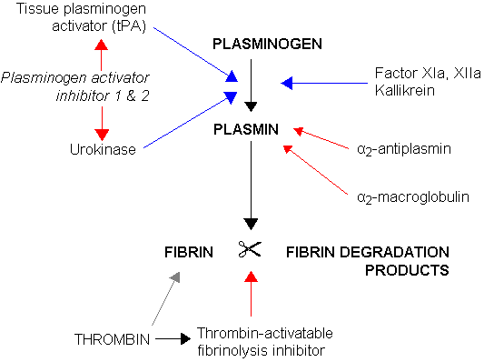
classic wikipedia diagram

Slide 5
cost
VIDAS - D-dimer cost is approximately $20.92 per test, including labor, supplies, and specimen processing

Slide 6
What causes d-dimer levels to rise?
A raised d-dimer is evidence that fibrin was cross linked, which is evidence of the coagulation cascade being activated
Specifically, thrombin must have been formed to break soluble fibrinogen into fibrin, and factor XIII must have been activated for the cross linking
This means patients lacking factor XIII may not have raised d-dimers despite having formed a massive clot (fibrin made, but not cross linked)
(So the next time you are asked to do a CTPA on a patient with a negative d-dimer, ask the consultant why he suspects factor XIII deficiency)
(A very small clot might also lead to a false negative)

Slide 7
Common indications
Low risk VTEs
Using conventional cut-offs from metanalysis of 12497 patients with non high probability of VTE: Specificity Age 51-60: 57.6% Age > 80: 14.7% Sensitivity >97% in all assays

Slide 8
Interesting indications
Monitoring response to anticoagulation
My sister was working at Watford General. There was a 26 year old woman who had an unprovoked above knee DVT just under 3 months ago. She was under the GI team for long standing diarrhoea. The GI team were unsure if she still needed to be on warfarin and spoke to the haematologist.

Slide 9
Did the haematologist…?
A) Follow the 6 week DVT plan and stop anticoagulation?
B) Follow the 3 month plan and continue until then?
C) Order a d-dimer?
D) Continue lifelong anticoagulation?

Slide 10
Amazing
The answer was c).
WTF?
It makes sense when you think of d-dimer as a marker of activation of the coagulation system
Patients with unprovoked are at massive risk of recurrence (>9% per year) which outweighs the bleeding risk

Slide 11
BSH Guidelines on OAC
Given that this risk exceeds the risk of warfarin-related bleeding, patients with a first unprovoked or recurrent unprovoked episodes of proximal DVT or PE should be considered for long term anticoagulation (Kearon et al, 2008). Whilst the cohort risk for patients with a history of unprovoked venous thrombosis is >9%, individual risk is heterogeneous. This is illustrated by a lower annual risk in patients with a normal D-dimer result after completion of initial warfarin therapy compared to those with an elevated D- dimer (3.5% vs. 9%)

Slide 12
DIC
D-dimers are also elevated in DIC
They can be used like in VTE i.e. for their high sensitivity and negative predictive value
DIC is a consumptive coagulopathy, so consumption of clotting factors, platelets and fibrinogen leads to:
Raised PT
Raised APTT
Low platelets
Low fibrinogen

Slide 13
False positives
Hospitalized patients
After surgical procedures
Pregnancy
Inflammation
Malignancy
Trauma
Liver disease (decreased clearance)
Heart disease

Slide 14
How to cancel CTPAs
D-dimer levels increase with age; this is not new.
http://www.bmj.com/content/346/bmj.f2492
“The application of age adjusted cut-off values for D-dimer tests substantially increases specificity without modifying sensitivity, thereby improving the clinical utility of D-dimer testing in patients aged 50 or more with a non-high clinical probability.”
This age adjusted cut off is age×10 µg/L compared to our lab’s cut off of 230 µg/L
In other word, a d-dimer of 453 µg/L in a 74 year old man would be treated as negative, and does not need further imaging.

